Slide 1
Difference of Limit by reference standard of RE ~Radiated Emission Limits~

Slide 2
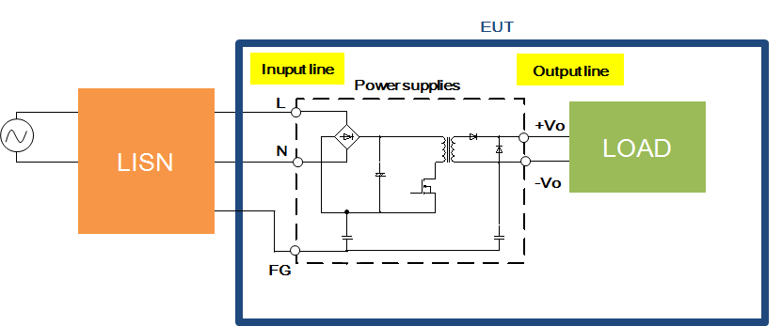
What is Radiated Emission Limits?
Noise Radiated from chassis, cables, etc.
Radiated noise
EUT
Power cable

Slide 3
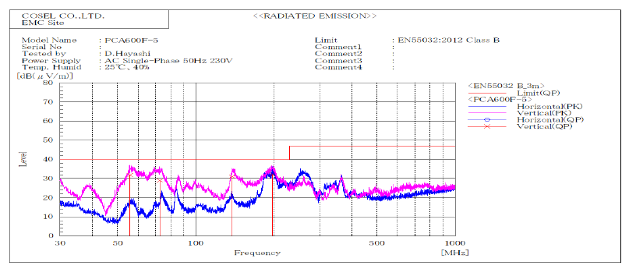
Example of test result
Example of test result is shown as below(PCA600F-5).
The horizontal axis is the frequency, and the vertical axis is the noise level. Noise level shall be below the limit to comply with the EMI standard.
Noise Level
BAD !
Noise Frequency

Slide 4
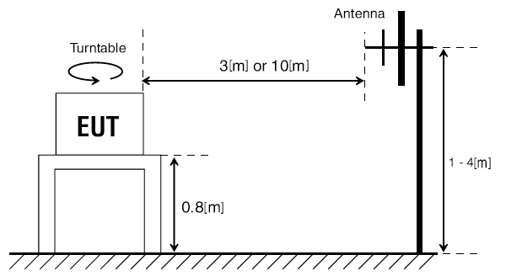
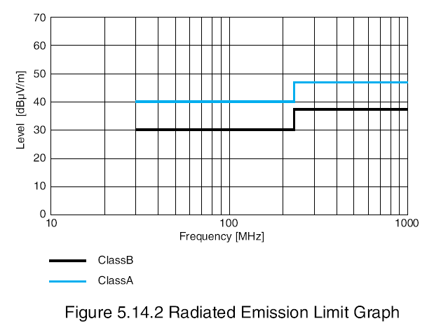
How is Radiated Emission measured ?
When operating equipment, the strength of electromagnetic waves is measured in a range of specified frequencies location 3 or 10 m away from the equipment. The limit value differs depending on which the distance.
Limit level depending on the 3m/10m method
No | Distance m | Frequency range MHz | Class B limits (uV/m)
1 | 10 | 30 to 230 | 30
2 |  | 230 to 1000 | 37
3 | 3 | 30 to 230 | 40
4 |  | 230 to 1000 | 47
10m
Fig Example of Radiated Emission
Measurement Configuration
10m
3m
Fig depending on which the distance

Slide 5
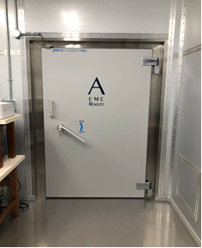
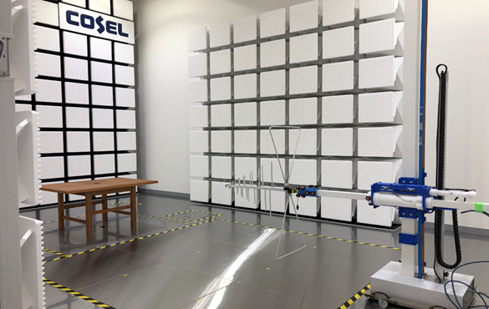
How is Radiated Emission measured ?
Cosel has an Anechoic chamber* complies with 3m low.
So, Cosel's power supplies Radiated Emission are measured by 3m low.
Turn table
Antenna
Anechoic chamber
Refers to a facility to be used to create an electromagnetically isolated environment; the interior
surfaces of the chamber absorb radio frequency waves.

Slide 6
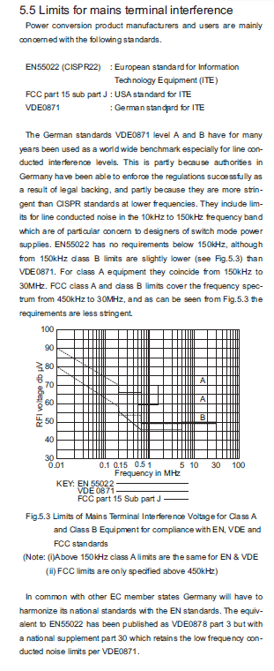
Name of EMI standard depending on the region
EMI standard name is different depending on the region.
The major standards are shown below.
: International Special Committee on Radio Interference
■ CISPR
: The Federal Communications Commission(U.S.A)
■ FCC
: Verband Deutscher Elektrotechniker(Germany)
■ VDE
■ VCCI
: Voluntary Control Council for Interference
by Information Technology Equipment(Japan)
・・・

Slide 7
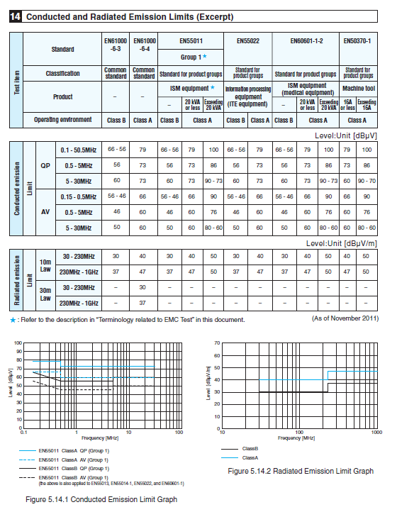
Limit level depending on the equipment
The limit value differs depending on the standard, and the limit value differs depending on the equipment. The limit value list for each standard is shown below.
Product

Slide 8
Limit level depending on the equipment
Assuming compliance with EN55011/55022, Cosel's power supplies are basically designed as bellow.
■Enclosed Type : Class B
■PCB Mount, Power module Type : Class A (with external parts)
* There are some exceptions, so please check the specification sheet for the detail.
＊ "Class B" is a stricter requirement
value than "Class A".
Fig Limits of EN55011

Slide 9
Summary
-The limit values are different depending on the customer's equipment and region/country. -Depending on the customer's requirement, to add a filter circuit for noise reduction might be necessary.
For example, using cable, casing etc. -When some customer has trouble with noise, please check the customer's requirement and limit value.

